Slide 1
AI Powered Financial Management App
User Manual
Author: Sarvagya Jagatram

Slide 2

Table of Contents
Acknowledgements
About Me
My Journey So Far
About the App
How to Use The App
Contact Information

Slide 3
Acknowledgements
`
I am grateful of the chance to learn about AI through this internship, and I sincerely thank Mr. Avishek for his assistance, which enabled me to construct this project.

Slide 4

About Me..
Sarvagya Jagatram
In DP 1 (11th Grade) of Genesis Global School
Currently enrolled in Clevered

Slide 5
My Journey With Clevered so far
During my internship with clevered, I gained a lot of knowledge about neurolinks and other aspects of artificial intelligence. My amazing experience has been further enhanced by Mr. Avishek's assurance that all of my questions have been addressed.

Slide 6
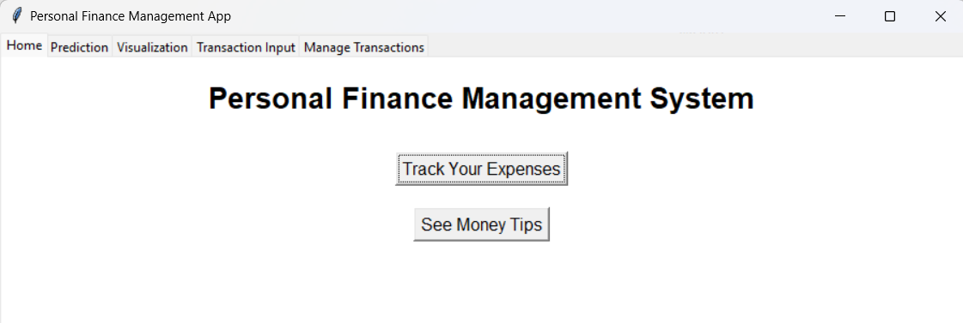
About App..
Using user data, the AI-powered financial decision tool forecasts improved financial choices and predictions for financial stability.

Slide 7

How to Use The App?
The APP Has 5 pages for the user to navigate

Slide 8
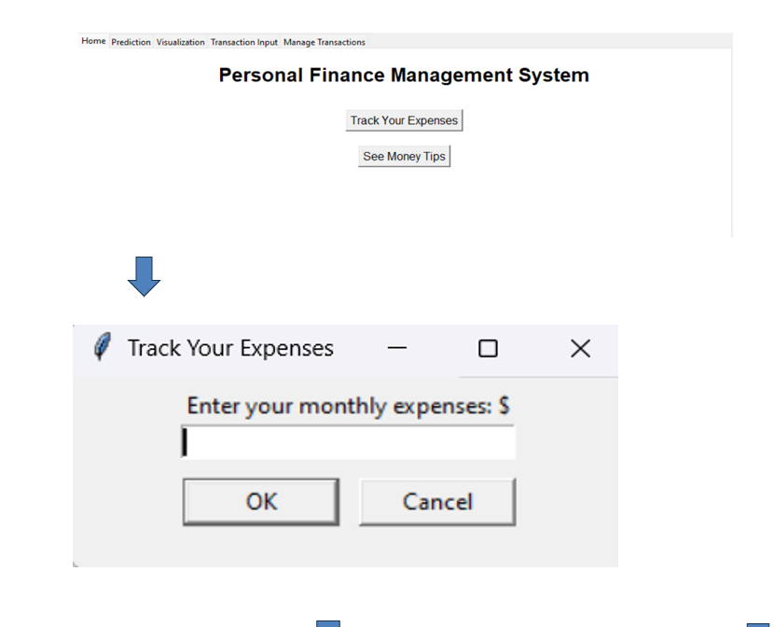
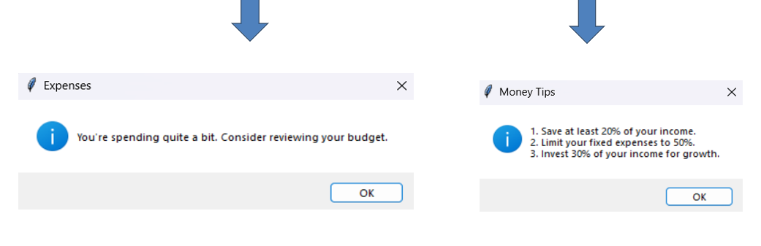
The Home Page
The platform provides the user with some money-saving tips and a general sense of whether their expenses are excessive or reasonable.

Slide 9
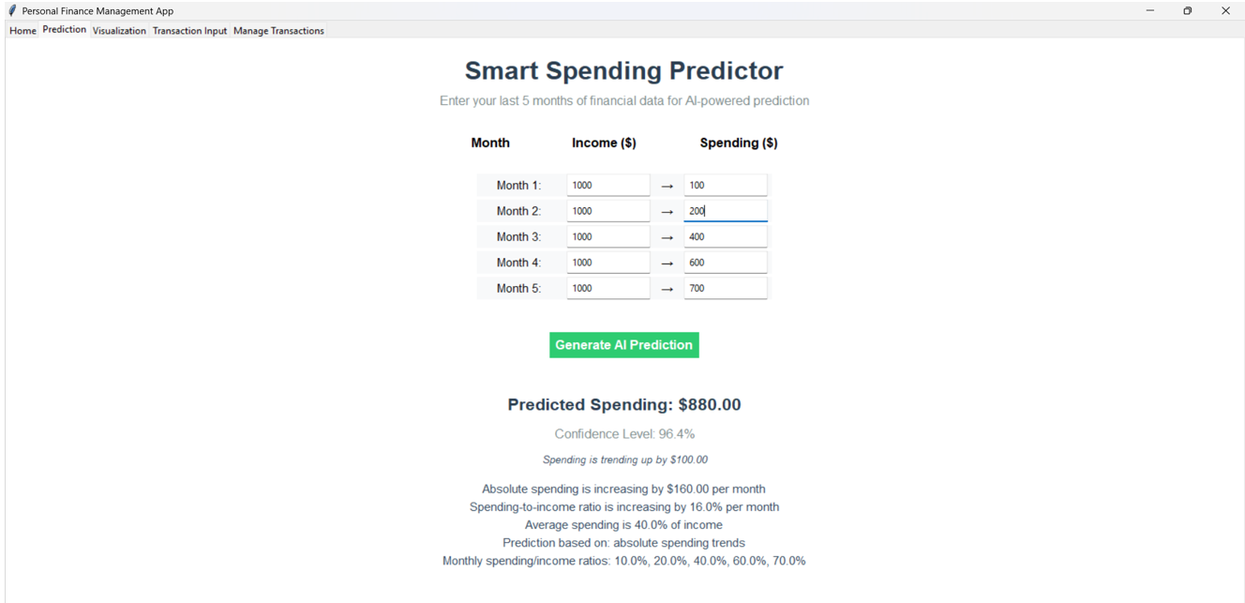
The Prediction Page
The platform gives information on typical expenditure and other trends, and it employs a linear regression model to forecast spending for the upcoming month based on the income to spending ratio.

Slide 10
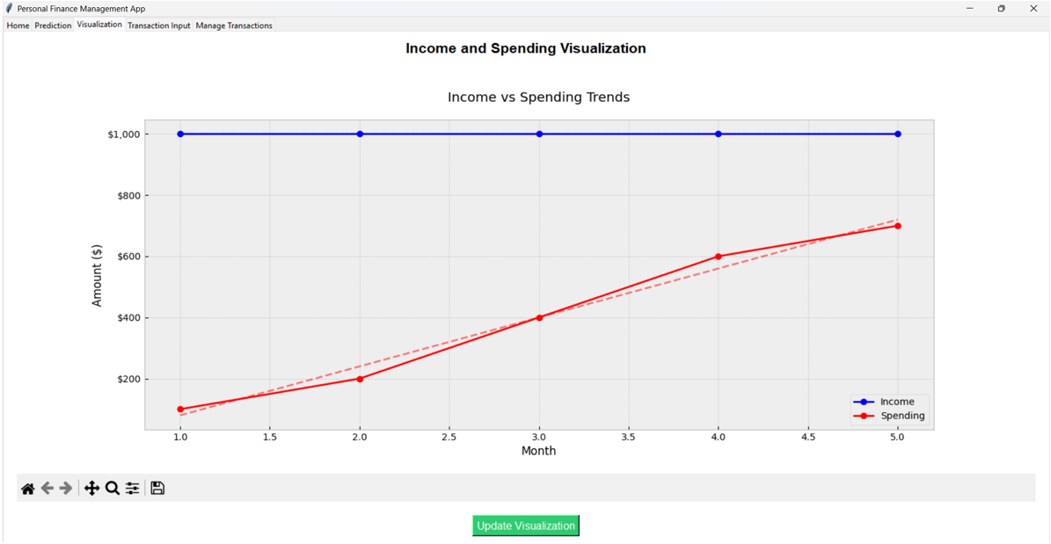
The Visualization Page
Using data from the Manage Transactions page, the visualisation tab creates two lines: the revenue and spending amount according to the months, along with the best fit line—using matplotlib. The Update Visualisation tab would function each time a piece of data was added or removed from other pages.

Slide 11
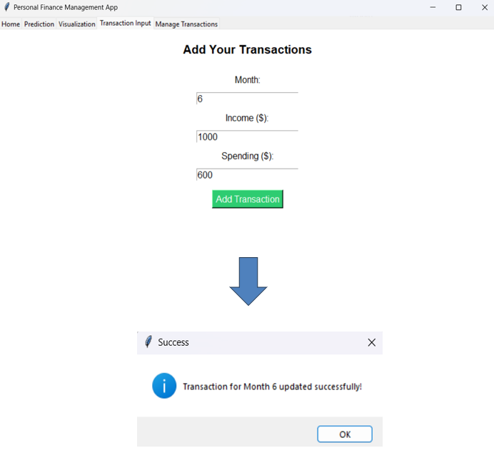
The Transaction Input Page
For the first five months, the app automatically pulls data from the prediction page. However, a financial tracking app needs more information, therefore this page lets you enter new months income and expenses and may be used to visualise the data.

Slide 12
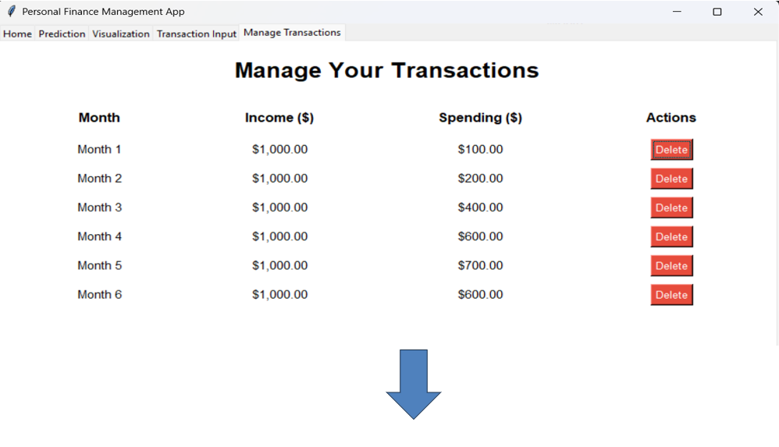
The Prediction Page
Because SQL is incorporated into the Manage Transactions page, a database is created locally, allowing the data to be configured each time it is added or removed. Two actions can be performed on this page: The first being delete.

Slide 13
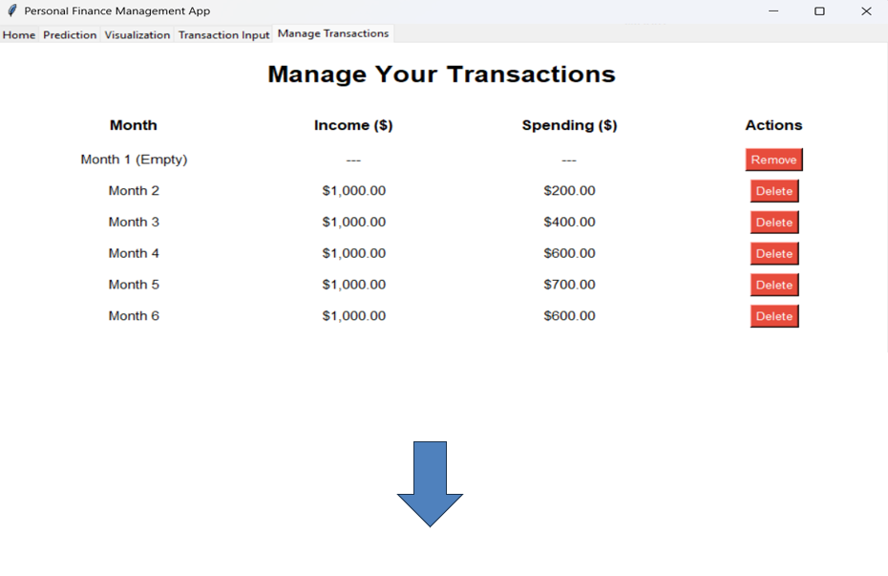
The Prediction Page
A remove option has been added since the first action is to eliminate a month's worth of data, which sets the income and spending to zero and would appear as zero in the visualisation.

Slide 14
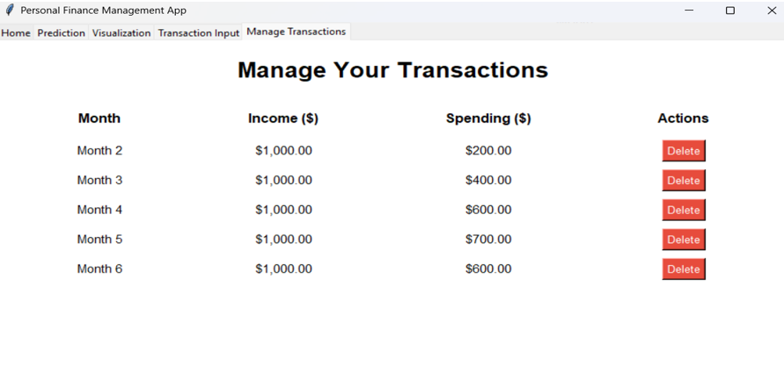
The Manage Transaction Page
To ensure that the value is permanently erased and does not appear in the database or visualisation, the Remove action has been implemented. By adding the data to the prediction or transaction input page, all of the data can be over writed.

Slide 15
Contact Information
Please reach out to Sarvagya Jagatram at sarvagya.official12@gmail.com for any questions, concerns or suggestions on the App

Slide 16
Thank you!

